Slide 1
Speeding Up Neural Networks

Slide 2
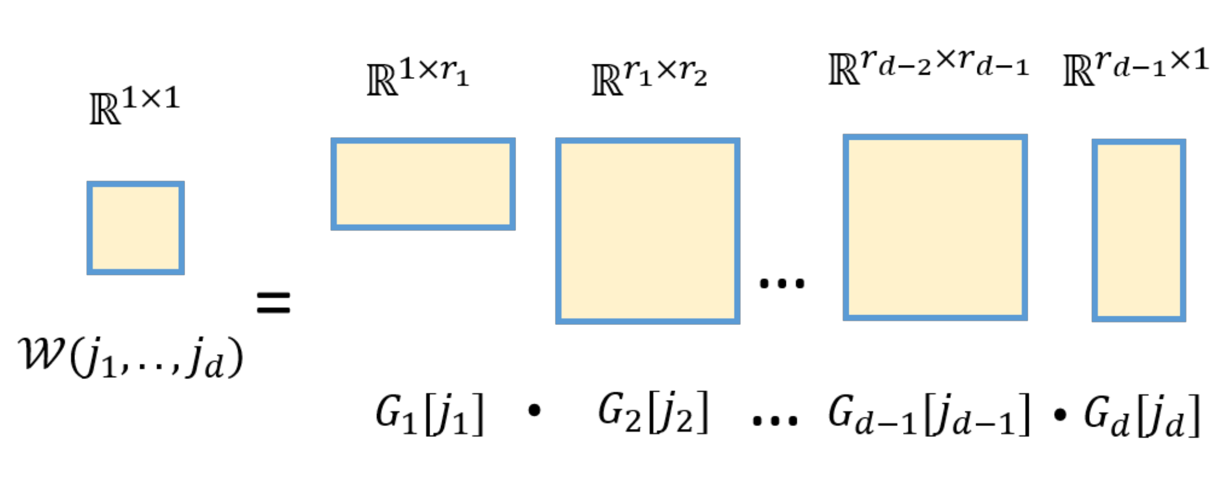
Tensor Decomposition
Conv is defined by its four-dimensional weight array W
Idea is to decompose into a product of low-dimensional tensors

Slide 3
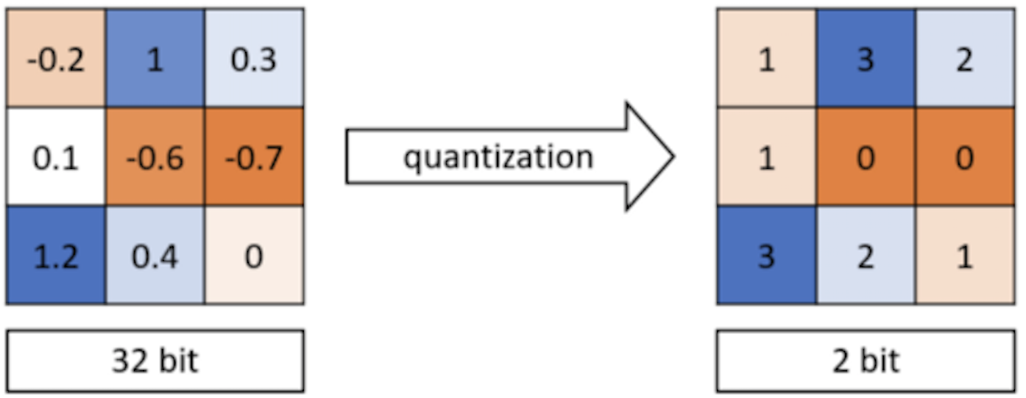
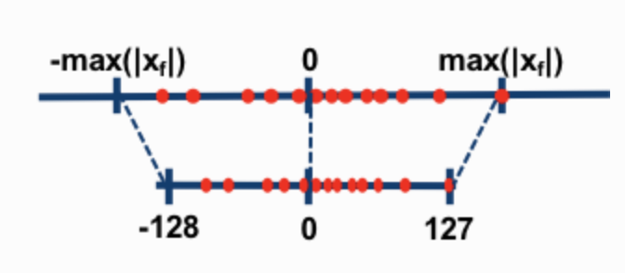
Quantization
Switch to low-precision arithmetic

Slide 4
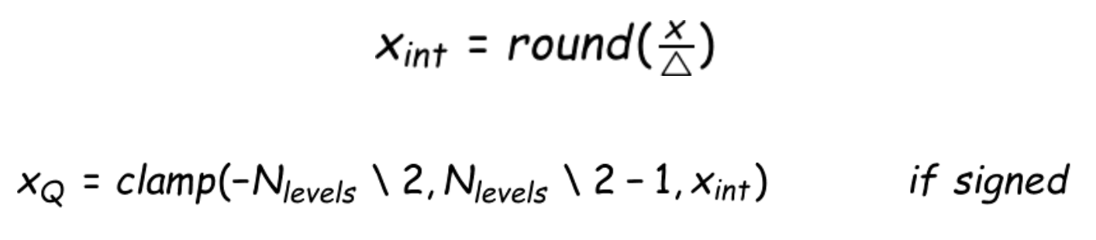
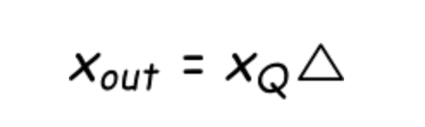
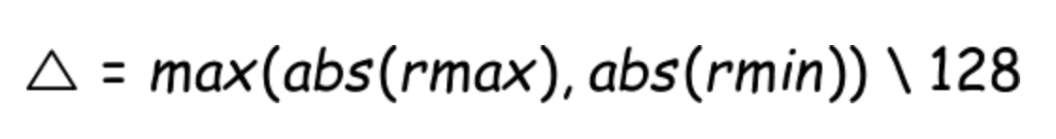
Symmetric Quantization

Slide 5
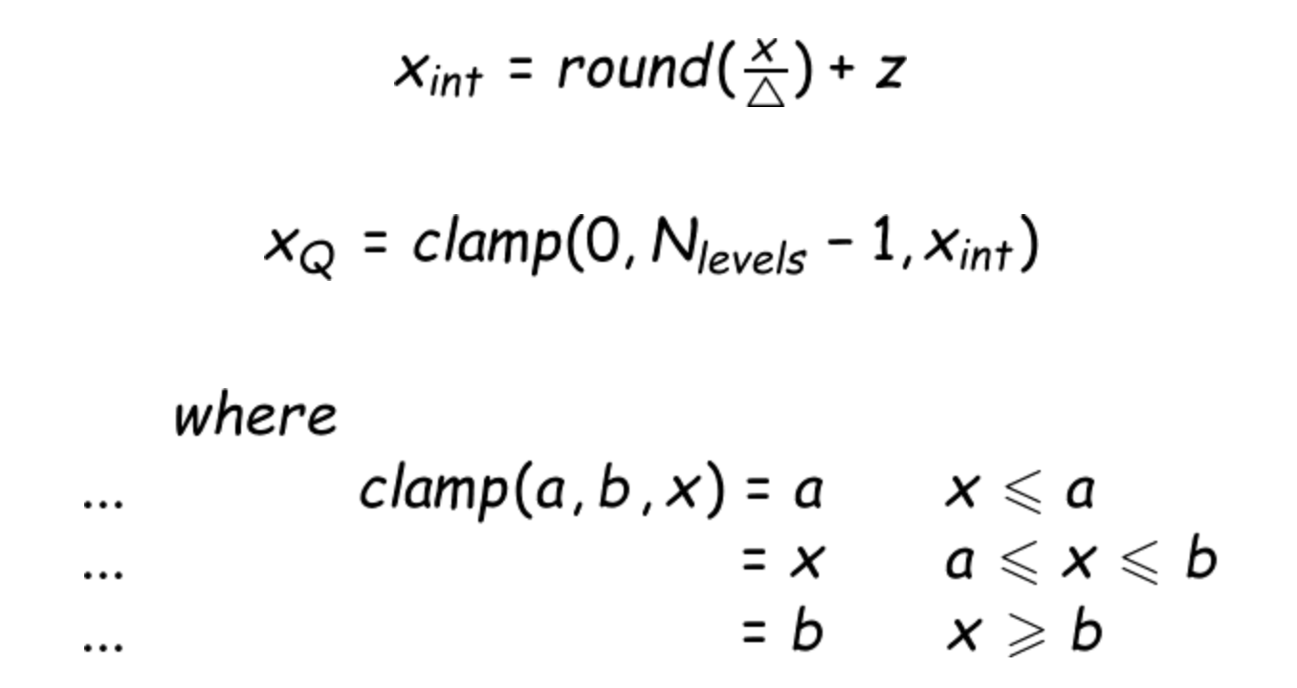

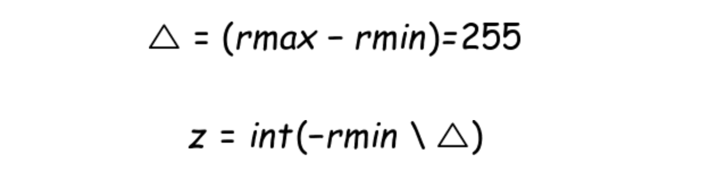
Asymmetric Quantization

Slide 6
Quantization in PyTorch
Dynamic quantization weights quantized with activations read/stored in floating point and quantized for compute
Static quantization weights quantized, activations quantized, calibration required post training
Quantization aware training weights quantized, activations quantized, quantization numerics modeled during training
PyTorch Quantization

Slide 7
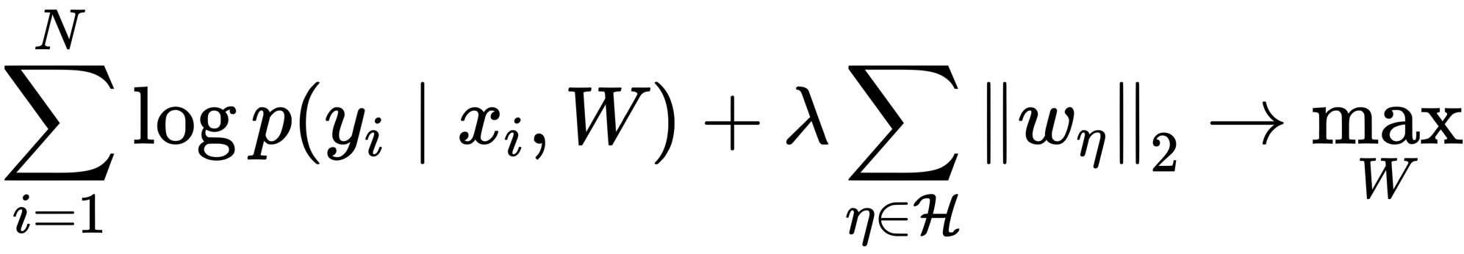
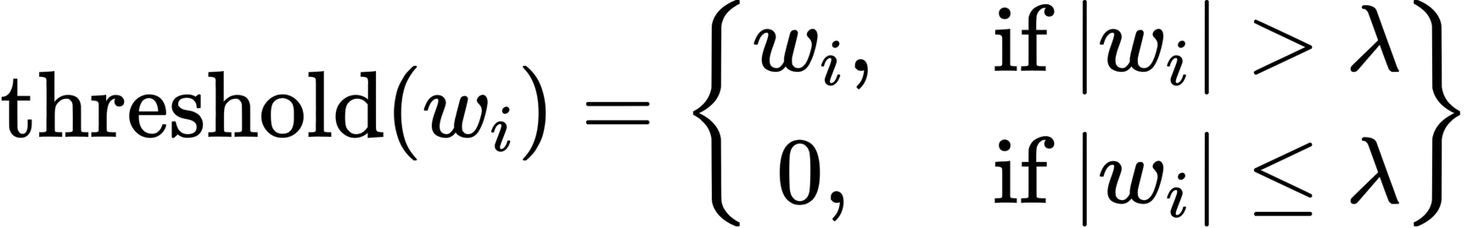
Pruning
Weights with small magnitudes do not contribute much
Trimming weights by threshold
Different scheme for changing the threshold and zeroing weights
PyTorch Pruning

Slide 8
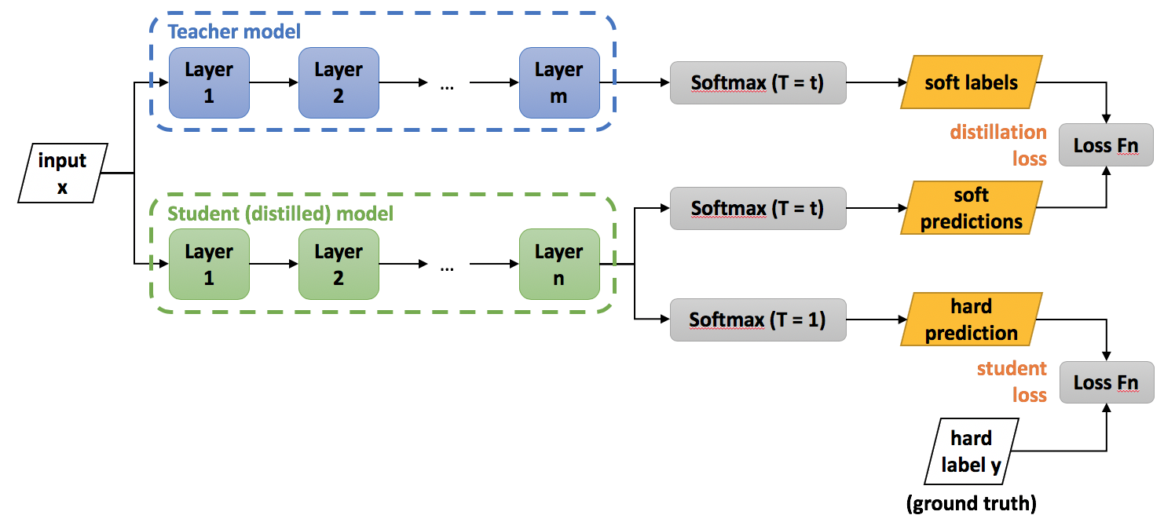
Distillation

Slide 9
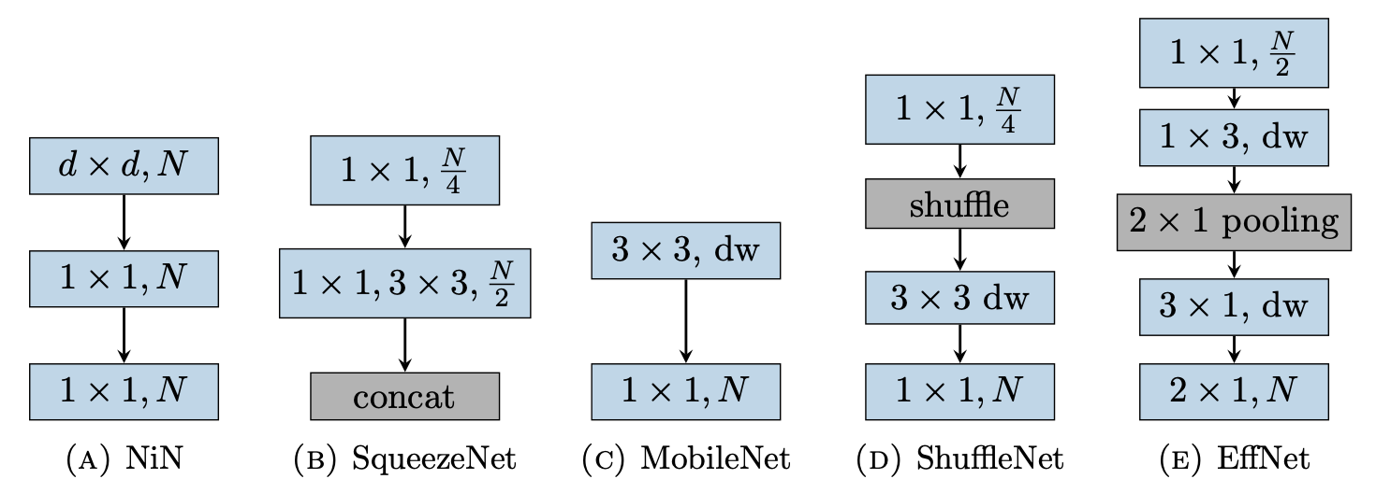
Architecture Design

Slide 10
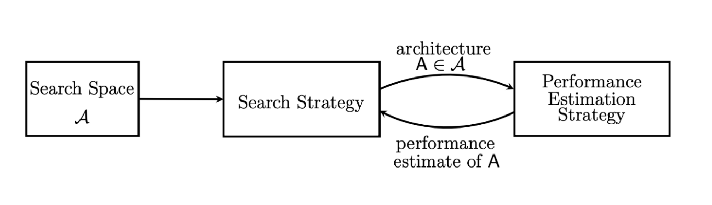
Neural Architecture Search

Slide 11
But actually...
Profile you model by parts
Write custom kernels
Check I/O bottleneck
Precache / load on device
DALI

Slide 12
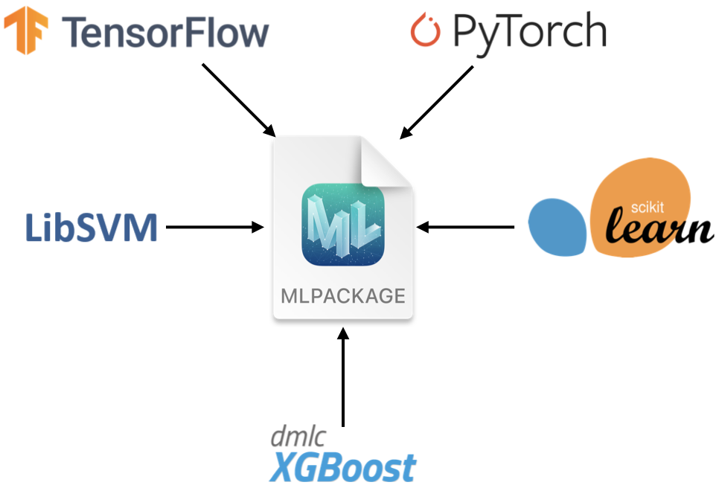
How to deploy model on iOS?
CoreML
PyTorch Mobile

Slide 13

How to optimize inference?
TensorRT (GPU)
Mixed Precision Inference
Layer Fusion
Batching
Optimization for specific hardware
OpenVINO

